Slide 1

VRD Digraph Visualiser
App-Synth
Demo One

Slide 2
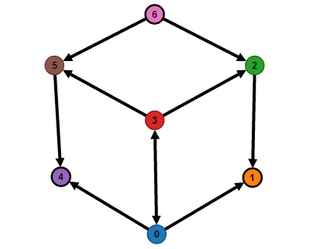
The Project
Create an application that requires virtual 3D digraph visualization propagated onto a spatial 3D virtual reality space.
Visualization make provision for Virtual 3D digraph which have defined using a set of triples
Application should allow user to change viewpoint on 3D plane to allow them to have different views within this dimensional sphere
System should allow the user to manipulate the digraph nodes and edges into different positions and also be able to create, update and delete links/edges between nodes through hand gesture interaction

Slide 3
Project Scope
On the front-end: The users will
On the back-end: There will be a web server which takes care of all the heavy processing and sends back information to the app
The server will communicate with the app through
App
Server

Slide 4
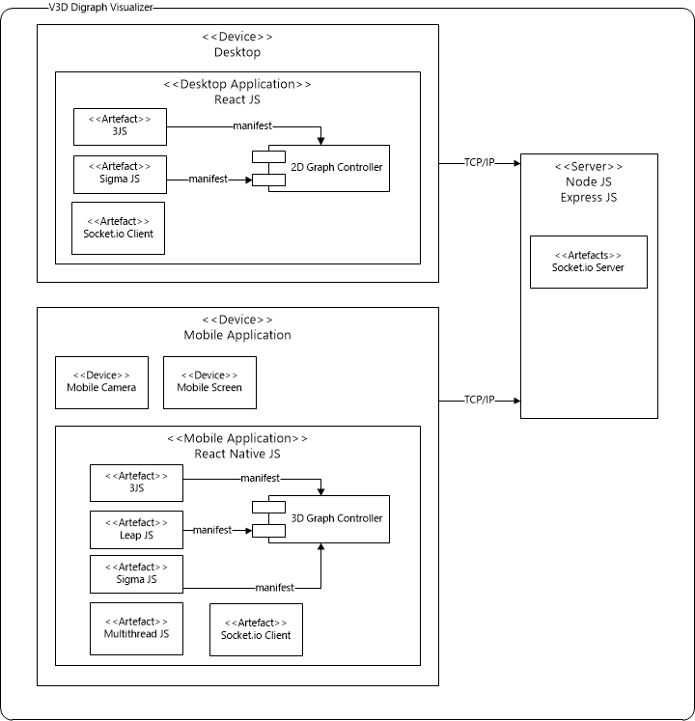
Project Deployment

Slide 5
Initial Software Architecture

Slide 6
Functional Requirements
Load digraph from file into space
Change graph view and zoom
Set criteria for force direction
Manipulate graph using hand gestures
Sync graph with external display

Slide 7
Initial Non-Functional Requirements
High performance - Real time communication between view and external display
Scalability – System must be robust and modular, allowing easy addition of additional features
Reliability – Ability to track hand movements and capture gestures accurately and adjust graph accordingly
Security – Must not inadvertently put user’s information at risk through vulnerabilities

Slide 8
Implementation Details
Sigma graph modelling library (java script)
Create cross platform application
Native cross platforms application (React-Native/Other)
3JS for creation of 3D space
Google cardboard for immersive graph rendering
Multithread.js to run multiple processes for performance optimization (faster sync & graph generation

Slide 9
Initial Design Patterns
Observer
Command
Memento
State
Interpreter

Slide 10
Demo

Slide 11
External Interface Requirements (Interface Requirements)
The main user interface will be in the form of a virtual reality space. Through this space, the user will be able to make various interactions with the system by means of hand gestures. The application itself will have a graphical user interface which the user can make use of in order to alter various configurations of the application.

Slide 12
External Interface Requirements (Software Requirements)
There are multiple software packages and libraries which will be used within the system in order to implement the required functionality. (Mention a list)The application will need to be compatible with the Google Android operation system, as well the Apple iOS operating system.

Slide 13
External Interface Requirements (Hardware Requirements)
The system will require the presence of a virtual reality device in order to allow for a virtual reality space to be displayed. The application will be deployed on a mobile phone. As such, the mobile device should be able to meet the minimum requirements in order to run the virtual reality application.

Slide 14
External Interface Requirements (Communication Requirements)
There are various components of the system which will have to communicate with one another in order for the system to provide its required functionality. (Mention a list of libraries and how they would need to communicate)

Slide 15
What’s next?
Intensive Research
On propagating the digraph onto a 3-dimensional space
Network optimization

